Slide 1


Unit 1
Data collection responsibilities
Notes:
Welcome to Unit 1 of Module 6.

Slide 2
By the end of this unit, you will be able to:
identify the data collection responsibilities for the different team members
Notes:
By the end of this unit, you will be able to identify the data collection responsibilities for the different team members.

Slide 3



Data collection team
The HHFA data collection team consists of 3 core roles:
data collector
team leader
area supervisor
Notes:
The HHFA data collection team consists of 3 core roles:
the data collector;
the team leader; and
the area supervisor.
We will now look at the responsibility of each role in more detail.

Slide 4
Data collector’s responsibilities
HHFA data collector
Responsibility:
to collect high-quality HHFA data based on training received during the Data Collection Training workshop
Notes:
It is the responsibility of the data collector to collect high-quality HHFA data based on training received during the Data Collection Training workshop.

Slide 5
Data collector’s responsibilities
HHFA data collector
collect the HHFA data in the designated health facilities
apply the interviewing skills learned during the data collection training
use the:
mobile data collection device
HHFA CSPro application
Notes:
The data collector should collect the HHFA data in the designated health facilities, according to the questionnaire sections assigned to them.
They should apply the interviewing skills learned during the data collection training, and use:
the mobile data collection device; and the
HHFA CSPro application.

Slide 6
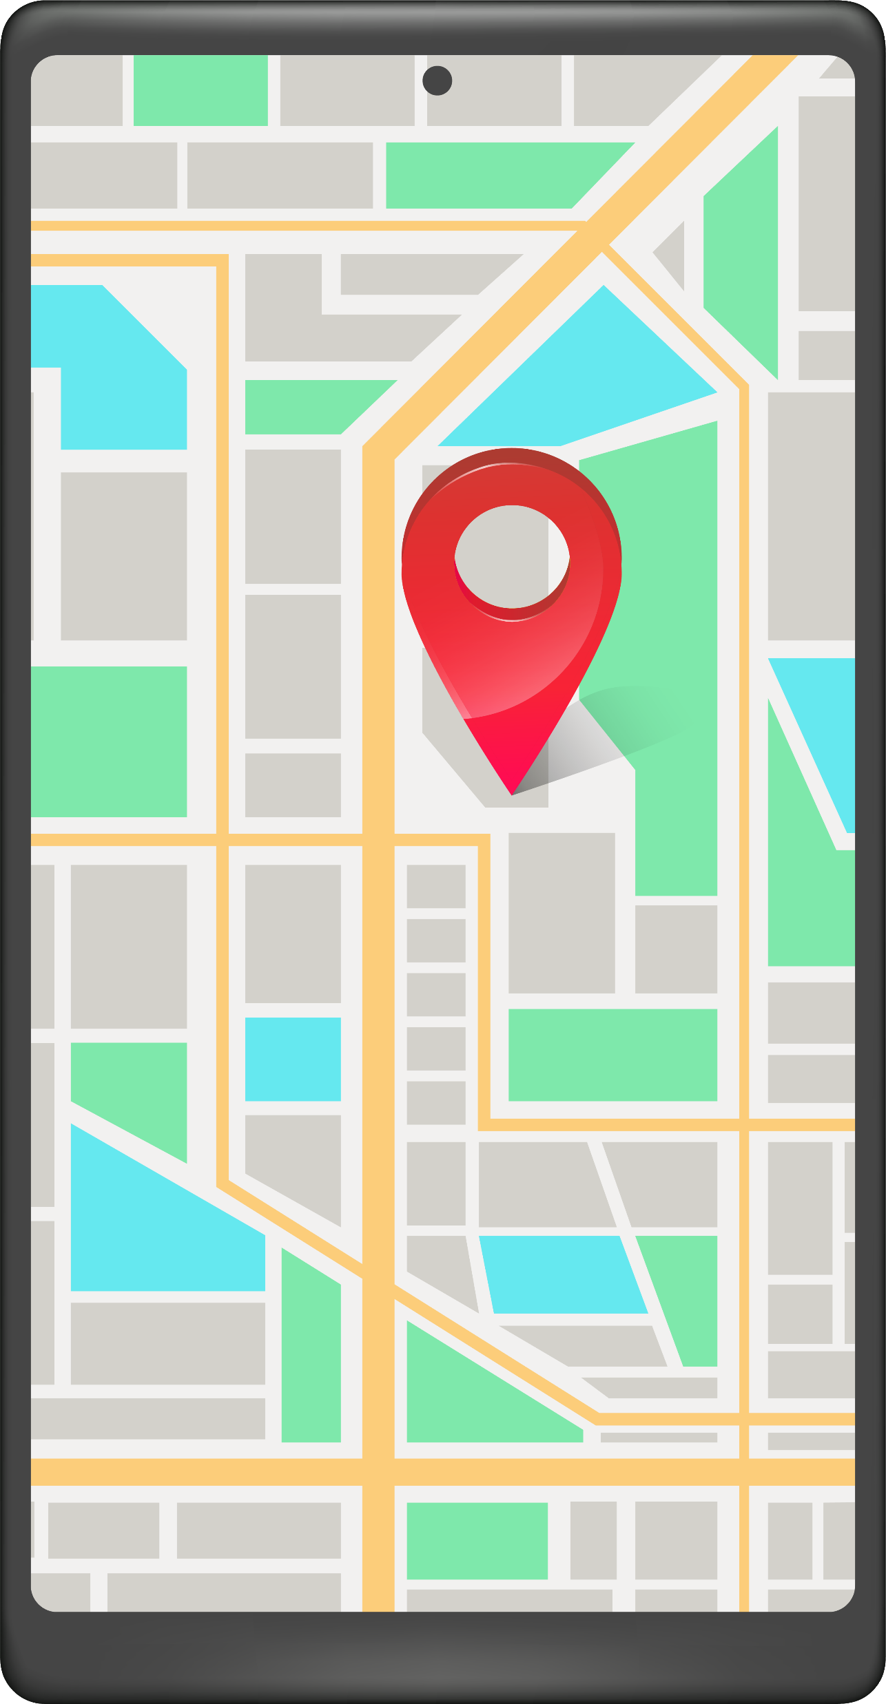
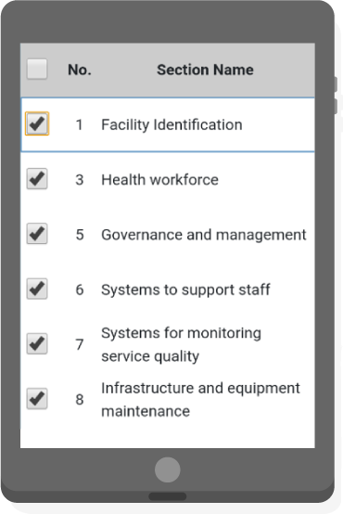
Data collector’s responsibilities
record the GPS coordinates of each visited health facility
check that assigned questionnaire sections are completed
transfer completed questionnaire sections to the team leader
Notes:
The data collector should also:
record the GPS coordinates of each visited health facility;
check that all the questionnaire sections assigned to them are completed (using a special feature of the CSPro application) and fill in any gaps before leaving the health facility; and
transfer the completed questionnaire sections to the team leader according to the established data management procedures

Slide 7
Team leader’s responsibilities
HHFA team leader
Responsibility:
leading a team of HHFA data collectors
ensuring that data are collected according to quality standards
ensuring synchronization of the data to the server
Notes:
The team leader is responsible for:
leading a team of HHFA data collectors;
ensuring that data are collected according to quality standards; and
ensuring synchronization of the data to the server.

Slide 8



Team leader’s responsibilities
prepare a schedule of facility visits
make an appointment for the data collection visit
assign sections of the questionnaire to the data collection team
introduce the team to the facility in-charge
Notes:
The team leader is also a data collector. In addition to their tasks as a data collector, the team leader should also:
prepare a schedule of facility visits for the data collection team and share it with the team members and area supervisor;
make an appointment with the assigned health facilities for the data collection visit;
for each facility, assign all the required sections of the questionnaire to the data collection team; and
introduce the team to the facility in-charge and explain the purpose of the visit.

Slide 9
Team leader’s responsibilities
The team leader should also:
create a complete facility record
check that the data for the facility are complete
The team leader should contact the area supervisor concerning any problems encountered during data collection.
Notes:
Furthermore, the team leader should:
create a complete facility record by combining the data files from all the data collectors on completion of the data collection for each facility; and
check that the data for the facility are complete and ensure the synchronization of the data to the server.
The team leader should contact the area supervisor concerning any problems encountered during data collection.

Slide 10
Area supervisor’s responsibilities
HHFA area supervisor
Responsibility:
all aspects of data collection in the region
ensuring the accuracy and consistency of data collection
Notes:
The area supervisor is responsible for:
all aspects of data collection in the region; and
for ensuring the accuracy and consistency of data collection.

Slide 11

Area supervisor’s responsibilities
The area supervisor should oversee and coordinate the teams of data collectors in the assigned area.
Notes:
The area supervisor should oversee and coordinate the teams of data collectors in the assigned area.

Slide 12



Area supervisor’s responsibilities
plan the work of data collectors
facilitate access to health facilities
ensure data collection equipment is available and functioning
ensure that logistic means are effectively deployed
Notes:
In close consultation with the survey manager, the area supervisor should:
plan the work of data collectors, assigning them to the health facilities, and preparing a schedule of their deployment;
facilitate access to health facilities to be assessed;
ensure that the equipment for data collection is available and functioning; and
ensure that logistic means are effectively deployed to transport data collectors to assigned health facilities.

Slide 13
Area supervisor’s responsibilities
The area supervisor should also:
monitor the process of data collection using CSPro
accompany data collector teams to facilities (rotating among teams)
troubleshoot problems during data collection
validate data collection
Notes:
The area supervisor should also:
monitor the process of data collection using the required CSPro functions;
accompany data collector teams to facilities on a rotational basis, to ensure that required processes are followed ;
troubleshoot when problems arise during data collection;
validate data collection by repeating a subsection of the questionnaire in about 10% of the surveyed facilities.

Slide 14
You have now completed Unit 1.
In the next unit, we will look at fieldwork planning.
First, try the practice exercise.
Notes:
You have now completed Unit 1.
In the next unit, we will look at fieldwork planning.
First, try the practice exercise.

